Slide 1
Patient Recording and Monitoring Instruments Module-4 Conventional instrument system
COMBINATION
OF INPUTS
UNKNOWN
SYSTEM
Established the relationship between inputs and outputs
Many outputs will show wide range of responses to a given set of inputs

Slide 2
Physiological Systems…
Human body contains various types of systems:
Vision
Hearing
Smell
Taste
Inspired air
Sensation
Liquid intake
Food intake
Identification
Speech
Behavior
Appearance
Expired air
Liquid waste
Food waste
ELECTRICAL
MECHANICAL
ACOUSTIC
THERMAL
CHEMICAL
HYDRAULIC
PNEUMATIC
OPTICAL
COMPUTER
COMMUNICATION
CONTROL

Slide 3
Components in Man – Instrument system
Control feedback
Transducer
Signal conditioning equipment
Display
Stimulus
Transducer
Transducer
Recording , data processing and transmission of data

Slide 4
Block diagram ……..:
Basic(General) block diagram of Medical or Man Instrumentation system.
Functional components
Measurand (subject)- stimulus
Sensors/Transducers
Signal conditioner-pre amplifier, signal processing
Output devices - Alarams
-Display
-Data storage
-Data transmission
-Data recording
Control System

Slide 5
Medical(Man) Instrumentation System
Block Diagram
Control
System
(Energy
Sources)
Electric
Light
Infrared
Mech.
Ultrasonic
Alarm
Display
Data storage
Data Trans
Data Rec
calibration
Measurend
Sensors/
Transducer
Pre Signal
Amp. Processing
Signal conditioner

Slide 6
Man(Medical) instrumentation system
Includes both the human being(living organism) & the instrumentation required for measurement of the parameters related to human being
Attempts to measure and understand the internal relationship of the human body organs
To help the medical clinician and researchers for obtaining reliable and meaningful measurements from a human being
The concept of the man-instrument system is applicable to both clinical and research instrumentation

Slide 7
Classification of instrumentation system
Clinical instrumentation
Research instrumentation
Measurements obtained from such Instrumentation-
In-vivo measurement
In-vitro measurement

Slide 8
Factors to be cosidered:
Factors to be consider for obtaining reliable and meaningful measurements from a living organism-
No endanger to the life of the person
No undue pain, discomfort, other undesirable conditions
Safety consideration
The hospital environment
Medical personnel must involved
Ethical and legal consideration

Slide 9
Basic objectives
Basic objectives of
Medical or Man Instrumentation system-
Information gathering
Diagnosis
Evaluation
Monitoring
control

Slide 10
Constraints in design of Medical Instrumentation System:
Measurement range(uv)
Frequency range(<AF, 0 or Very low freq.)
Additional Constraints-
Inaccessibility of the signal source
Variability of Physiological parameters
Interface among Physiological systems
Transducer interface problems
Higher possibility of artifacts
Safe levels of applied energy
Patient safety consideration
Reliability aspects
Human factor consideration
Government regulations

Slide 11
General Consideration Design of Medical Instrumentation System:
General consideration:
Signal consideration: Types of sensors, sensitivity, range, input impedance, frequency response, accuracy, linearity, reliability, differential or absolute input
Environmental Consideration:
S/N ratio, Stability, atmospheric temperature, pressure, humidity, vibration, radiation, etc
Medical Consideration:
Invasive or Non-invasive technique, patient discomfort, radiation and heat dissipation, electrical safety, material toxicity, etc.
Economic Consideration
Initial cost, cost and availability of consumables and compatibility with exiting equipments

Slide 12
L3: Sources of Bioelectric Potential
Biosignal/Biopotential
The ionic potential originated with the result of electrochemical activity of certain special cells/tissues
own monitoring signals, which convey information about the functions they represent.
Such signals are associated with nerve conduction, brain activity, heart activity, muscle activity etc
Ionic voltage
Electric voltage
Transducer

Slide 13
L3: Sources of Bioelectric Potential
Biosignal/Biopotential
Such signals:
Used for extracting information on a biological systems(physiological systems)
Phenomenon that conveys information which is used for diagnosis
Process of extracting information could be as simple as feeling pulse of a person on the wrist or as complex as analyzing the structure of internal soft tissues by an ultrasound scanner

Slide 14
Cont..
S. No | Signals | sources
1 | EEG, ENG, EMG | Nervous system
2 | EOG | Occular System
3 | ERG | Corniel Retinal Position
4 | ECG | Cardiovascular system
5 | PULSE RATE | ,,
6 | BLOOD PRESSURE | ,,
7 | BLOOD FLOW | ,,
8 | PCG | Heart valves
9 | EMG | Muscular system
10 | EGG | Gastroinstinal track

Slide 15
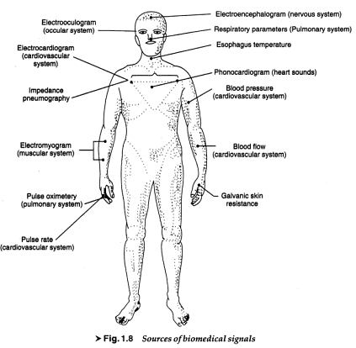
SOURCES OF BIMEDICAL SIGNALS:

Slide 16
Classifications Biopotentials/Biomedical signals:
Classifications of Biopotentials/Biomedical signals:
Biopotentials For Examples
Bioelctric signals: ECG, EMG, EEG, EOG, ERG, EGG
Bioacoustic signals: Blood flow thr Heart valve sound
Biomechanical signals: Movement of the chest walls
Biochemical signals: pCO2, pO2
Biomagnetic signal: MagnetoEG
Biooptical signal: transmitted/back scattered light
Bioimpedance: Galvanic skin resistance
Details-

Slide 17
Cont…
Bioelctric signals: The electric field generated by the action of many cells constitutes the bioelectric signals. They are generated by nerve or muscle cells, basic source is the cell membrane potential eg ECG, EMG, EEG, EOG, ERG, EGG
Bioacoustic signals: Such biomedical signals provides information about the underlying phenomena. eg flow of blood in the heart, through the heart’s valve and flow of air through the upper and lower airways and in the lungs
Biomechanical signals: Originate from mechanical functions of the biological systems. Includes motion and displacement signals, pressure and flow signals. eg movement of the chest walls in accordance with the respiratory activity.
Biochemical signals: Obtained as a result of chemical measurement of living tissue or from samples analyzed in the lab. eg measurement of pCO2, pO2 and concentration of various ions in the blood.

Slide 18
Cont…
Biomagnetic signal: Extremely weak mag. fields produced by various organs(Brain, Heart, Lungs) it provides imp. inf. which is not provided by bioelectric signals eg magnetoEnG from the brain.
Bio-optical signal: Result of optical functions of the biological systems, occurring either naturally or induced by the measurement process eg blood oxygenation may be estimated by measuring the transmitted/back scattered light from a tissue at different wavelengths.
Bioimpedance: The impedance of the tissue is a source of important information concerning its composition, blood distribution and blood volume etc. It is also obtained by injecting current in the tissue and measuring voltage drop across tissue Impedance. eg Galvanic skin resistance and the measurement of respiration rate based on bio-impedance technique.
Such signal comprises resting & action potential

Slide 19
Action potential & Resting potential
Source for Biopotential
nerve cells and muscle cells
Resting potential ,Action potential
States of cell: Polarised state
Depolarised state
Repolarised state
(Semi permeable membrane):Depolarisation phase and
Repolarisation phase
Electrical activity associated with one contraction in a muscle

Slide 20
Cont..
Typical cell potential waveform
Typical terms:
Resting potential and action potential
Depolarization and Repolarization phase
Sodium pump
All-or-nothing law
Net height of the action potential
Absolute refractory period
Relative refractory period
Propagation rate/Nerve conduction rate/conduction velocity

Slide 21
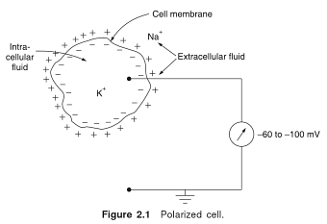
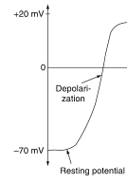
Polarized state and Resting Potential..

Slide 22
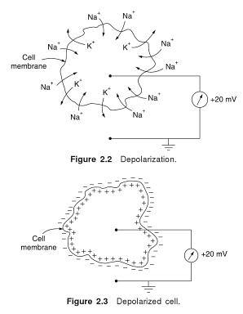
Depolarized state and Action Potential..

Slide 23
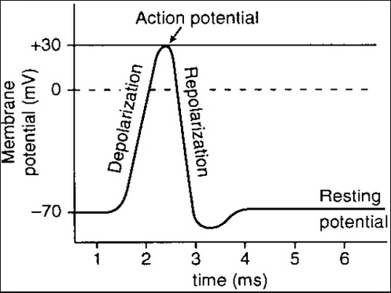
Action potential & Resting potential
Na⁺
Na⁺
Cl⁻
Polarised state
K⁺
K⁺
Na⁺
Cl⁻
Cl⁻
Na⁺
Na⁺
Na⁺
Cl⁻
K⁺
Na⁺
Na⁺
Cl⁻
K⁺
K⁺
Na⁺
Cl⁻
Cl⁻
Na⁺
Na⁺
Cl⁻
Semi permeable membrane
K⁺
Na⁺
Na⁺
-70mv

Slide 24
Action potential & Resting potential
Polarised state
K⁺
K⁺
Cl⁻
^{Na+}
^{Na+}
Semi permeable membrane
Cl⁻
Cl⁻
K⁺
K⁺
Na⁺
Na⁺
K⁺
K⁺
20 mv

Slide 25
CELL POTENTIAL:

Slide 26
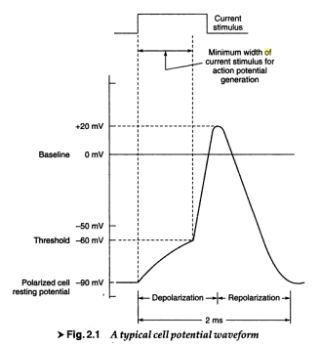
CELL POTENTIAL:

Slide 27
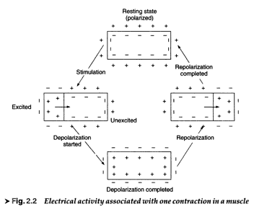
Cell membrane potential process:

Slide 28
All or Nothing law: The action potential is always the same for any given cell irrespective of method by which cell is excited and intensity of the stimulus. Net Height of the action potential: Difference between the peak of the action potential and the resting Potential. Absolute refractory period: Brief period of time during which the cell can not respond to any new stimulus(1msec in nerve cells) Relative refractory period: Period of time during which another action potential can be obtained with a much stonger stimulation (several msec ). Its result of after potential.

Slide 29
Propagation rate: The rate at which an action potential moves down a fiber or propagated from cell to cell is called propagation rate.( Nerve conduction rate: 20-140m/sec, Heart muscle: 0.2-0.4 m/sec, special time delay fibers between the atria and venticles: 0.03 -0.05m/sec

Slide 30
L4: Different bioelectric Signals:
Importance of various bioelectric signals
Electrical activity of various cells(body organs ) results in biopotentials.
Nature and important features of bio-Signals like
ECG, EEG, EMG

Slide 31
Different bioelectric signals
The primary characteristics of typical bioelectric signals:
Parameter | Primary Signal characteristics |  | Type of Electrode
 | Frequency range | signal Amplitude
ECG | 0.05 to 120 Hz (100Hz) | 0.1- 5 mV (1mV) | Skin electrode
EEG | 0.1 to 100 Hz (100Hz) | 2- 200 uV (50uV) | Scalp electrode
EMG | 5 to 3000 Hz (100Hz) | 0.1- 5 mV (50uV) | Needle electrode
ERG | 0-20Hz | 0.5uv-1mV | Contact electrode
EOG | 0-100Hz | 10uv-3.5mV | Contact electrode

Slide 32
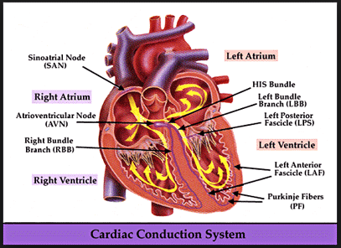
Cont…
features of important biomedical signals such as- ECG

Slide 33
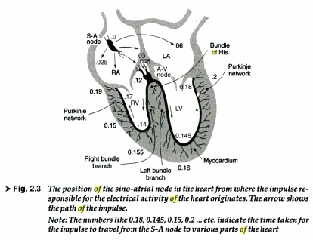
ELECTRO-CONDUCTION OF HEART MUSCLES:
Dept. of Electronics and Telecommunication Engineering

Slide 34
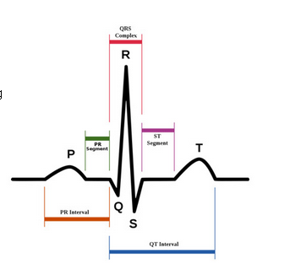
features of important biomedical signals such as- ECG

Slide 35

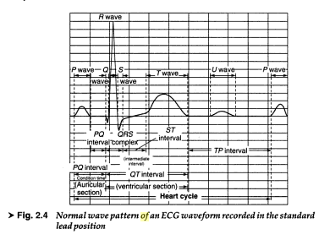
ECG SIGNAL :
Dept. of Electronics and Telecommunication Engineering

Slide 36
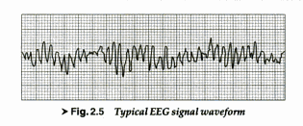
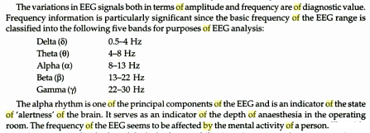
EEG SIGNAL :
Dept. of Electronics and Telecommunication Engineering

Slide 37
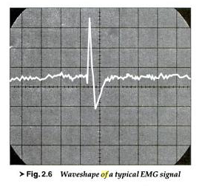
EMG SIGNAL :
VM Umale
Dept. of Electronics and Telecommunication Engineering

Slide 38
L5: Electrode theory- Basic electrode, Electrodes for ECG
Electrode theory
Need, types of Bio-potential electrodes.
Basic electrode theory
Various Electrodes for ECG.

Slide 39
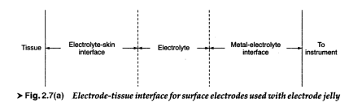
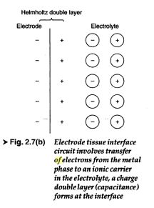
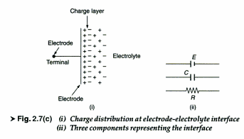
ELECTRODE - ELECTROLYTE & ELECTROLYTE-TISSUE INTERFACE
Dept. of Electronics and Telecommunication Engineering

Slide 40
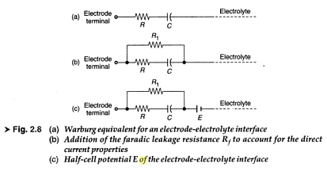
Electric equivalent circuits (warburg)
Dept. of Electronics and Telecommunication Engineering

Slide 41
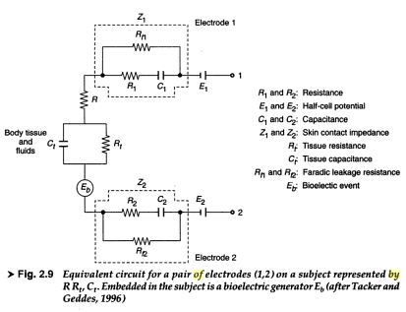
:
Dept. of Electronics and Telecommunication Engineering

Slide 42
Electrode theory- Basic electrode,
Need & Types of Bio-potential electrodes
Surface electrodes
Deep seated electrode
Factors to be consider while measurements:
Careful and suitable selection of electrodes for satisfactory record of bioelectric signal.
Comfortable for the patients to wear over long period
They should not produce any moving artefacts
Convenient in practical applications
Good contact with skin (for low contact impedance)

Slide 43
Cont..
The characteristics of a metalic/nonmetalic surface electrodes depends upon-
Condition at metal-electrolyte interface
Electrolyte –skin interface
Quality of electrolytes
Electrode properties
Why electrode jelly is required while measurements of biopotential signals?

Slide 44
Cont..
Electrode Potentials
All electrode potentials are measured wrt a ref. Electrodes
Ref. Electrodes-Hydrogen electrode (H absorbed on platinum back
-Calomel electrode
Electrode potentials of few metal electrodes wrt Hydrogen
Metal | Ionic symbol | Electrode Potential(Volt)
Aluminium | Al⁺⁺⁺ | -1.66
Iron | Fe⁺⁺ | -0.44
Lead | Pb⁺⁺ | -0.12
Hydrogen | H⁺ | -0.0
Copper | C⁺⁺ | +0.34
Silver | Ag⁺ | +0.80
Platinum | Pt⁺ | +1.2
gold | Au⁺ | +1.69

Slide 45
Cont..
potential between Electrode s in electrolyte
Electode Metal | Electrolyte | Potential difference between Electrode (mV)
Stainless steel | Saline | 10
silver | Saline | 9.4
Silver-silver chloride | Saline | 2.5
Silver-silver chloride (11mm disc) | ECG paste | 0.47
Silver-silver chloride (sponge) | ECG paste | 0.2

Slide 46
L6: Electrodes for ECG, EEG, EMG
Electrodes for ECG.
Electrodes for EEG,
Electrodes for EMG,
Biochemical Electrodes

Slide 47
Electrodes for ECG, EEG, EMG
Electrodes are used to pickup the biopotentials from the surface of the body of from inside the cells.
Basic electrodes are classified as:
Skin surface electrodes
Needle electrodes
Microelectrodes

Slide 48
Electrodes for ECG, EEG, EMG
Various Electrodes used for the measurement or recording of ECG signal.
Immersion electodes(not used now)
Limb electrodes
Suction cup electrodes
Floating electrodes
Spray –on electrodes
Pregelled disposable electrode
Pasteless (dry) electrodes
Air –jet ECG electrodes

Slide 49
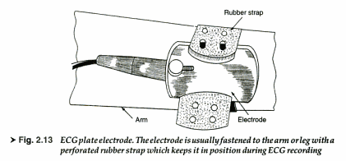
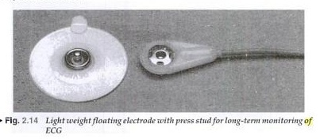
ECG Electrodes
ECG plate electrode.
The electrode is usually
Fastened to the arm
or leg with a perforated
Rubber strap which
keeps it in position
during ECG recording
Light weight floating
Electrode with press Stud
for long term monitoring

Slide 50
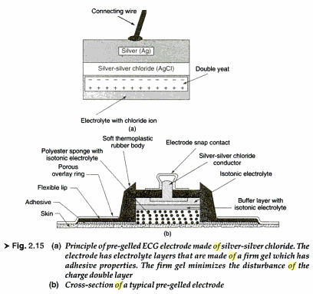
ECG Electrodes

Slide 51
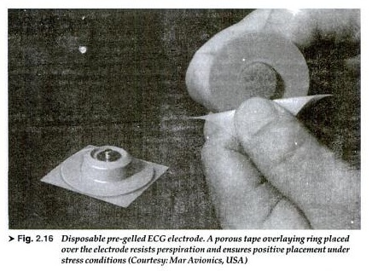
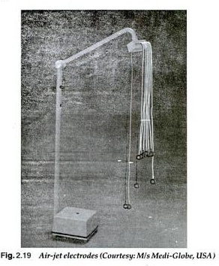
ECG Electrodes
Disposable pre-gelled
ECG Electrode.
A porous tape overlaying
placed over the electrode
resists perspiration and
Ensures positive placement
Under stress conditions
Air –Jet ECG Electrodes

Slide 52
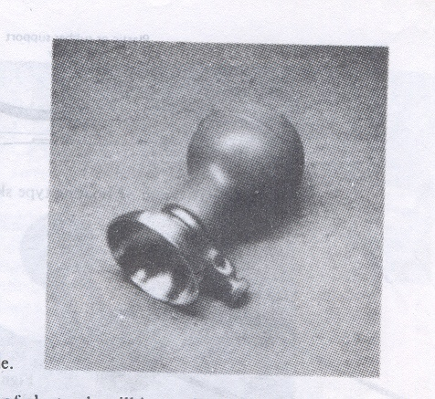
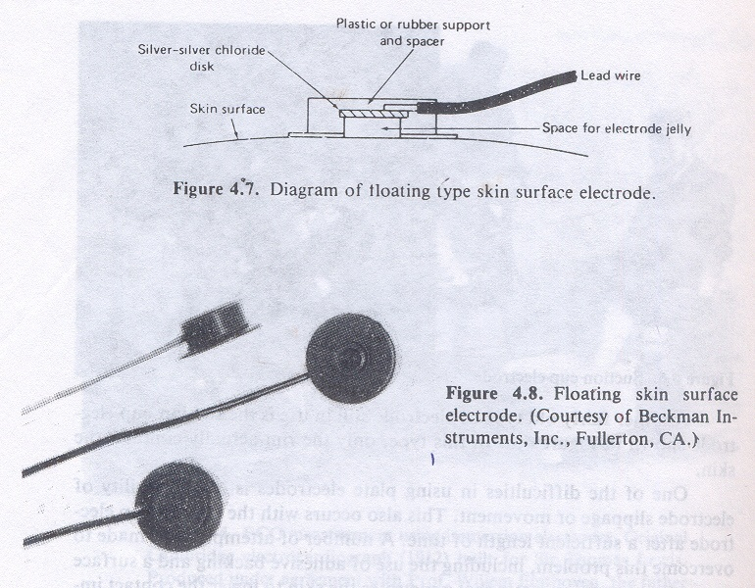
ECG Electrodes
Suction cup electrode
(Unipolar chest ECG
Electrode.)
Floating type skin surface
ECG Electrodes
52

Slide 53
Electrodes for ECG, EEG, EMG
Various Electrodes used for the measurement or recording of EEG signal.
Scalp surface electrodes (chlorided silver discs)
Ear-clip electrodes (reference electrode)
Small needle electrodes
Silver ball or pellet electrodes(exposed cortex, high resistance)
Pad electrode(silver ball is belled out at the end and padded with a sponge)
Chlorided silver wire in plastic cup electrodes

Slide 54
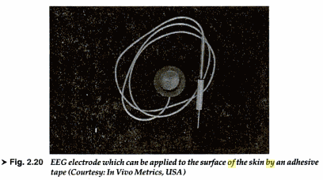
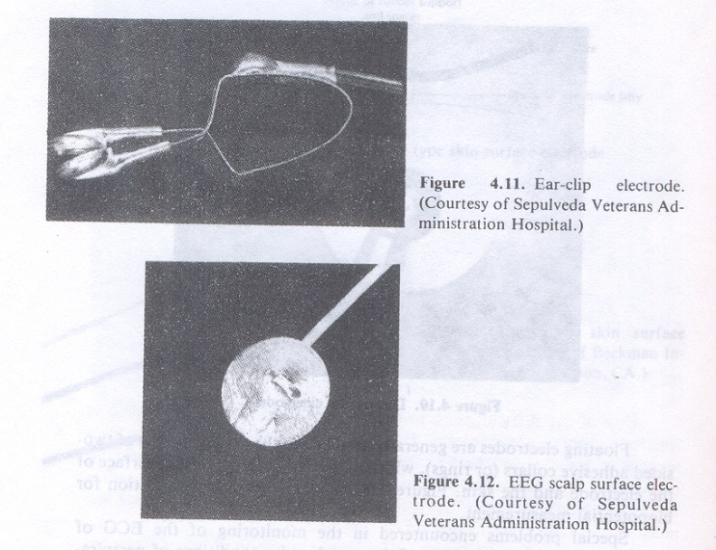
EEG Electrodes
EEG Electrode which can
Be applied to the surface
Of the skin by an
adhesive tape.
Ear-clip Electrodes
&
EEG scalp surface Electrodes

Slide 55
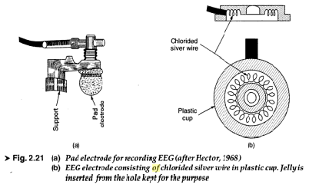
EEG Electrodes

Slide 56
Electrodes for ECG, EEG, EMG
Various Electrodes used for the measurement or recording of EMG signal.
Needle electrodes
Monopolar
Bipolar
Concentric core needle
Multi-element needle electrodes
Biochemical Electrodes
Reference electrode
pH electrodes
Blood Gas electrode

Slide 57
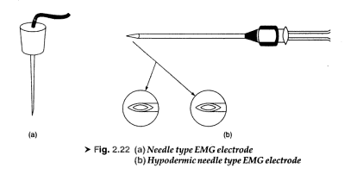
EMG Electrodes

Slide 58
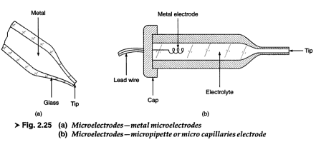
Micro Electrodes

Slide 59
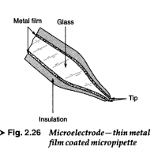
Metal micro-electrodes

Slide 60
Biochemical Electrodes
Biochemical Electrodes
Reference electrode
pH electrodes
Blood Gas electrode
pO2 Electrode
pCO2 Electrode

Slide 61
L7, L8: Nernst eq. & Skin contact impedance
Nernst equation
Skin contact impedance
Skin contact impedance measurement
Motion artifacts

Slide 62
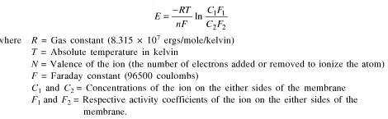
Nernst Equation:
VM Umale
Dept. of Electronics and Telecommunication Engineering

Slide 63
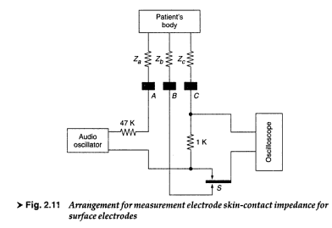
SKIN CONTACT IMPEDANCE MEASUREMENT:

Slide 64
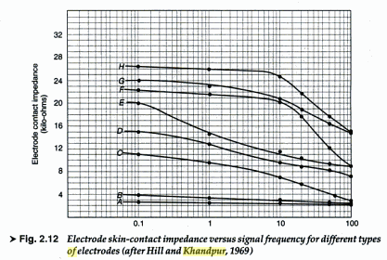
:

Slide 65
L9: Physiological System of Heart
Physiology of Heart
Physiological System of Heart- Hydraulic system
Physiological System of Heart- electrical conduction

Slide 66
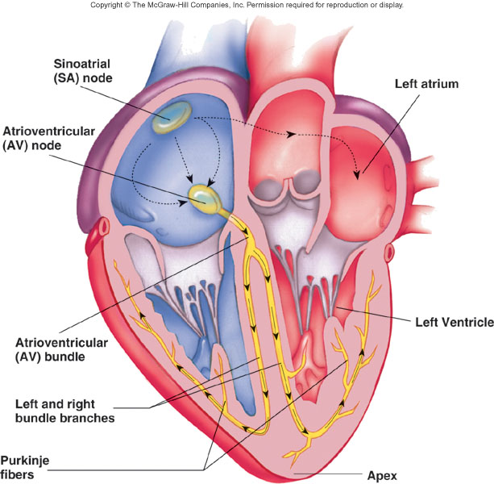
Conducting System of Heart

